Slide 1
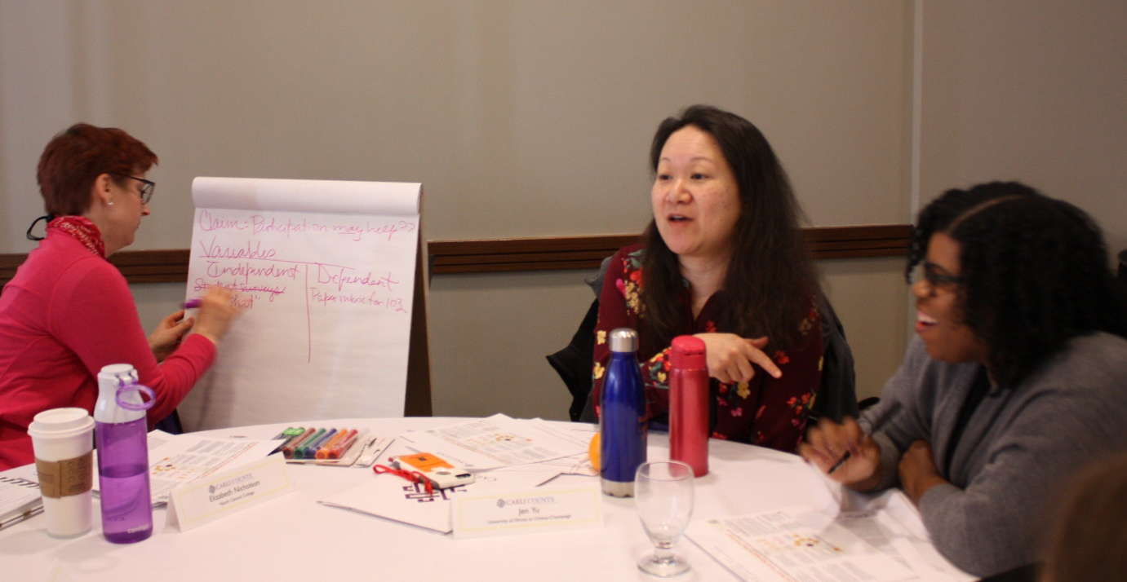
CARLI Counts Curriculum
Release Party
February 23, 2023
Feb. 23, 2023
This project was made possible in part by
the Institute of Museum and Library Services,
Grant Number RE-95-18-0084-18

Slide 2
CARLI Counts
An Introduction

Slide 3
How IT STARTED …
Laura Bush 21st Century Librarian Program Grant: $243,885
Four-year project: October 1, 2018-March 31, 2023
Funded Development and Three Cohorts
CARLI in partnership with:
University of Illinois Library at Urbana-Champaign
Lewis & Clark Community College
Website: https://www.carli.illinois.edu/products-services/prof-devel/carli-counts
This project was made possible in part by the Institute of Museum and Library Services (Grant Number RE-95-18-0084-18)

Slide 4
About carli
The Consortium of Academic and Research Libraries in Illinois (CARLI)
128 Governing Member libraries
All Illinois public universities : 13
All Illinois community colleges: 39
Private colleges and universities: 67
Special research libraries: 9
CARLI member libraries serve 90% of Illinois undergraduate students, 41% are minorities
Member libraries serve 90% of higher education students, faculty, and staff

Slide 5
Recognition of need and value among members
Notes:
We have also had a 2018 strategic planning process that exemplifies the members’ recognition of the importance of assessment for advocacy and building service priorities. “advocacy” is one of our five strategic priorities. The goal supporting the strategic direction is to “connect our members’ programs and services to outcomes.” I hope you see that across the membership, we’ve had a growing recognition of the importance of being able to share our impact.

Slide 6
High Level Overview
A continuing education library leadership immersion program based on the highly successful I-LEAD and Assessment in Action programs.
Prepares librarians to make effective use of research findings on the impact of academic libraries on student learning success for the twin purposes of service development and library advocacy.
Participants will learn how to use local library data analytics to improve their services and demonstrate their value in competitive campus budgeting processes, accreditation reports, and program reviews.

Slide 7
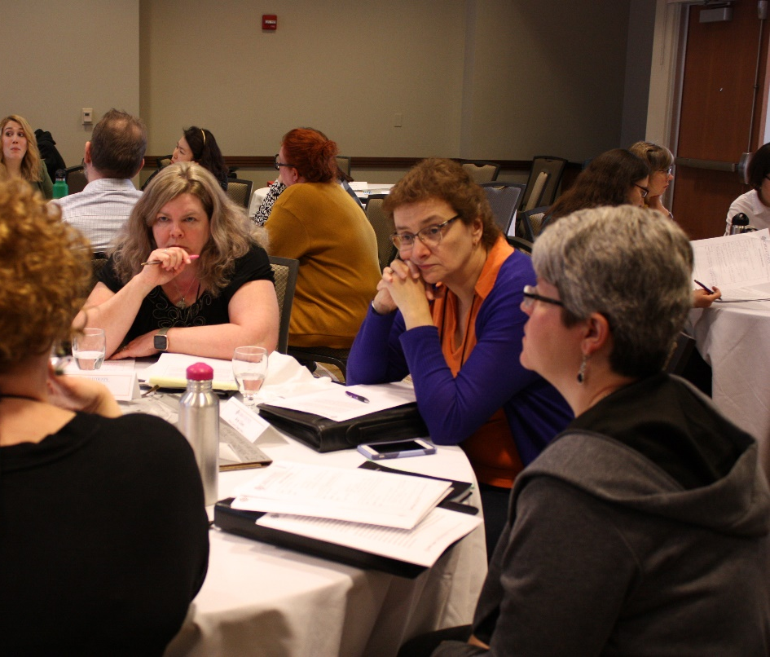
Goal
Illinois academic librarians will be able to effectively and systematically leverage national and local data in order to communicate impact narratives that convey to stakeholders how their libraries bolster student learning and success.

Slide 8
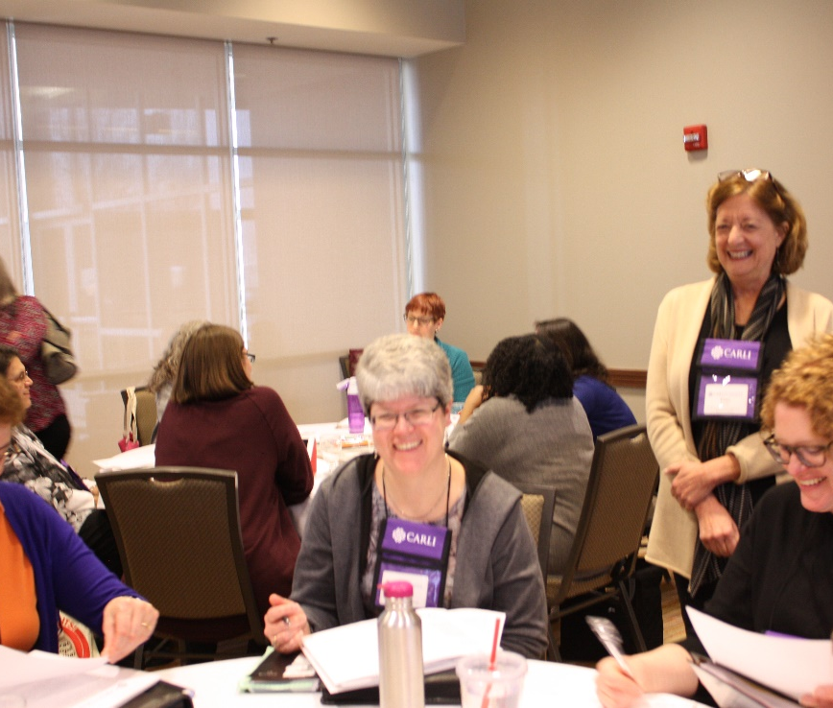
Outcomes
CARLI Counts participants are more confident in their skills and abilities related to service design and library advocacy.
CARLI libraries are better equipped to demonstrate their value to stakeholders.

Slide 9
CARLI Counts Grant Deliverables
A portfolio of local case studies and team posters.
An evaluation of the collective statewide impact of the program.
A replicable state/regional training model for equipping librarians to be campus leaders in assessing library impact on student learning and success.

Slide 10
CARLI Counts Grant Deliverables
A portfolio of local case studies and team posters.
An evaluation of the collective statewide impact of the program.
A replicable state/regional training model for equipping librarians to be campus leaders in assessing library impact on student learning and success.

Slide 11
CARLI Counts
Curricular Components and Instructional Design

Slide 12
Foundational Theories
Community of Practice
Action Research
Collective Impact
Value

Slide 13
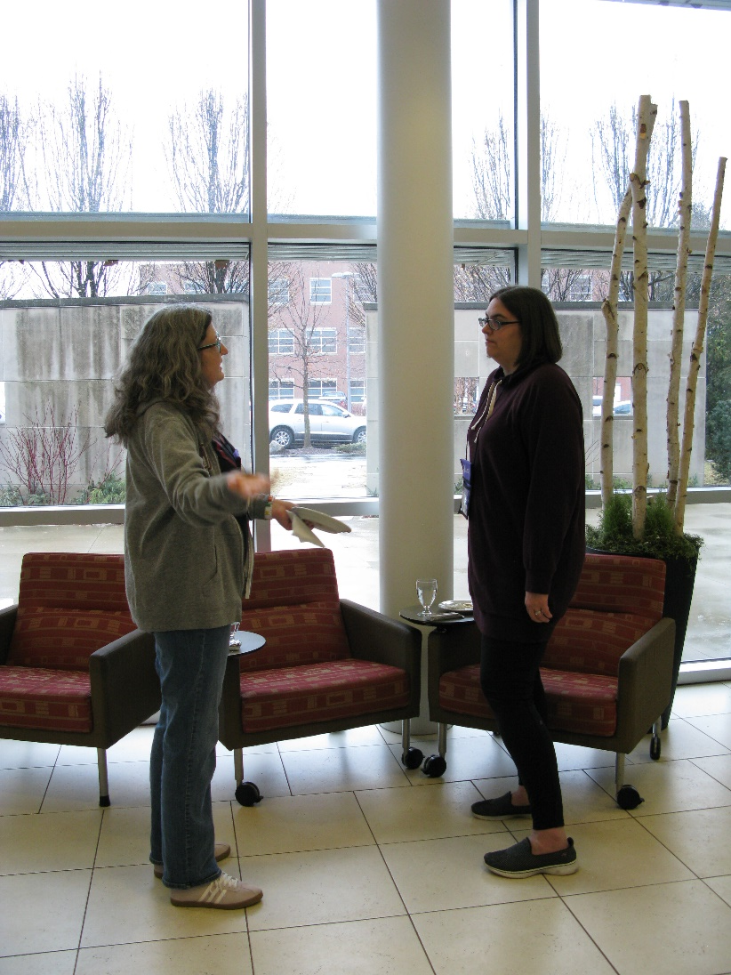
“Communities of practice are groups of people who share a concern or a passion for something they do and learn how to do it better as they interact regularly.”
http://wenger-trayner.com/introduction-to-communities-of-practice/
Notes:
allows for, but does not assume, intentionality: learning can be the reason the community comes together or an incidental outcome of member’s interactions

Slide 14
Action Research
“A participatory, democratic process concerned with developing practical knowing in the pursuit of worthwhile human purposes, grounded in a participatory worldview … It seeks to bring together action and reflection, theory and practice, in participation with others, in the pursuit of practical solutions to issues of pressing concern to people, and more generally the flourishing of individual persons and their communities.”
Peter Reason and Hilary Bradbury, Handbook of Action Research (London: SAGE Publications, 2006)

Slide 15
Collective impact, the commitment of a group of important actors from different sectors to a common agenda for solving a specific social problem.
Collective impact initiatives involve a centralized infrastructure, a dedicated staff, and a structured process … leads to a common agenda, shared measurement, continuous communication, and mutually reinforcing activities among all participants.
https://ssir.org/articles/entry/collective_impact
Notes:
Strive, both the organization and the process it helps facilitate, is an example of collective impact, the commitment of a group of important actors from different sectors to a common agenda for solving a specific social problem. Collaboration is nothing new. The social sector is filled with examples of partnerships, networks, and other types of joint efforts. But collective impact initiatives are distinctly different. Unlike most collaborations, collective impact initiatives involve a centralized infrastructure, a dedicated staff, and a structured process that leads to a common agenda, shared measurement, continuous communication, and mutually reinforcing activities among all participants.

Slide 16
Value of Academic Libraries
“Few libraries exist in a vacuum, accountable only to themselves. There is always a larger context for assessing library quality, that is, what and how well does the library contribute to achieving the overall goals of the parent constituencies?”
Sarah Pritchard, "Determining Quality in
Academic Libraries,“ Library Trends, 1996
Notes:
Align libraries with institutional outcomes.
Empower libraries to carry out work locally.
Create shared knowledge and understanding.
Contribute to higher education assessment.

Slide 17
Structure of Participation
One Cohort Per Year:
Each Cohort Comprised of Multiple Teams
Each Team Comprised of Five Members and One Mentor
Learning Experiences:
Two Immersive Workshops
Five-Seven Webinars
Weekly/Bi-Weekly Team Meetings Led by Mentors
Poster Session at CARLI Annual Meeting

Slide 18
Evolving from Individual to Collaborative Projects
Cohort 1
8 Teams of Individuals
Cohort 2
6 Teams of Individuals
1 Collaborative Project Team
Cohort 3
7 Collaborative Project Teams

Slide 19
Developing Projects
Institutional Application
Focused Inquiry Question
Selection of Method(s)
Data Collection and Analysis
Survey
Interview
Descriptive
Exploratory
Experimental
Findings and Implications
Topic Refinement and Theory Exploration
Observation
Etc.
Focus Group
Patterns
Outliers

Slide 20
Program Logic Model
“A logic model is a systematic and visual way to present and share your understanding of the relationships among the resources you have to operate your program, the activities you plan, and the changes or results you hope to achieve.”
Resources
Activities
Outputs
Outcomes
Impact
Your Planned Work
Your Intended Results
Excerpted from W.K. Kellogg Foundation’s Logic Model Development Guide

Slide 21
Deliverables
Deliverables – Team and Individual
Team Poster
Individual Project Progress Report
Individual Learning Reflection

Slide 22
CARLI Counts
Program Outcomes

Slide 23
Learning – Key Finding:
Participants demonstrate learning across 13 key evidence-based practices increased from start of each cohort to completion.
EVIDENCE -BASED PRACTICE
Qualitative & Quantitative
Data Collection Methods
IRB/ Human Subjects
Communicate Results
Sources of Data
Ethics/ Privacy
Analyze & Interpret
Identify Campus Priorities
Connect to Campus Priorities
Measuring Variables
Identifying Variables
Collect Data
Data Needs

Slide 24
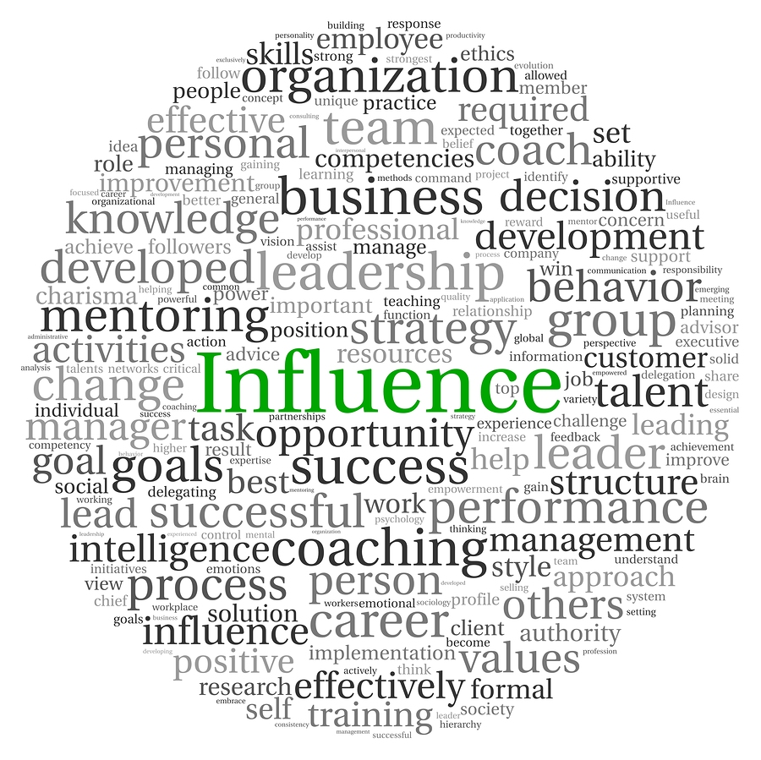
Leadership & Library Advocacy – Key Findings:
More confident about assessing the impact of the library
Perceive themselves a leader at their library & on their campus
Increased collaboration on campus
Campus recognition of expertise
Image source: unknown author; licensed under CC BY-NC-ND
This Photo by Unknown Author is licensed under CC BY

Slide 25
Teams – Key Findings:
Team Functions and Roles
Anchor in the midst of uncertainty
Sounding board for individual projects
Collegial sharing and support (beyond CARLI Counts)
Opportunity for reflective practice
Sustain a focus on learning
Relationship building
Image source: unknown author; licensed under CC BY-NC-ND

Slide 26
Mentors – Key Findings:
Building Team Cohesion
Role is to be a mentor, not a teacher
Facilitate group discussions
Importance of setting a positive tone for team
Help a diverse group find common ground
Recognize unspoken needs
Monitor and moderate progress on projects
Help group members handle competing priorities
Image source: unknown author; licensed under CC BY-NC-ND

Slide 27
CARLI Counts
The Open Curriculum

Slide 28
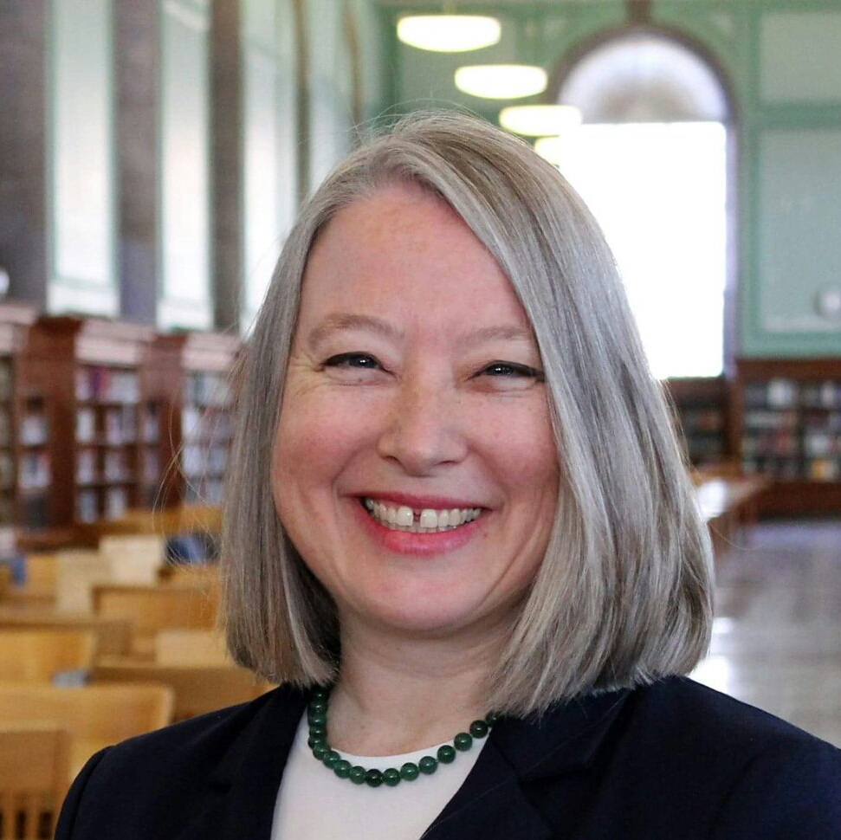
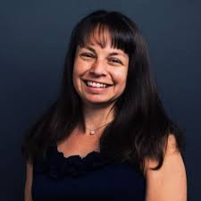
Co-Authors:
Lisa Janicke Hinchliffe
Curriculum Facilitator
CARLI Counts
Cathy Mayer
Curator and Editor
CARLI Counts

Slide 29
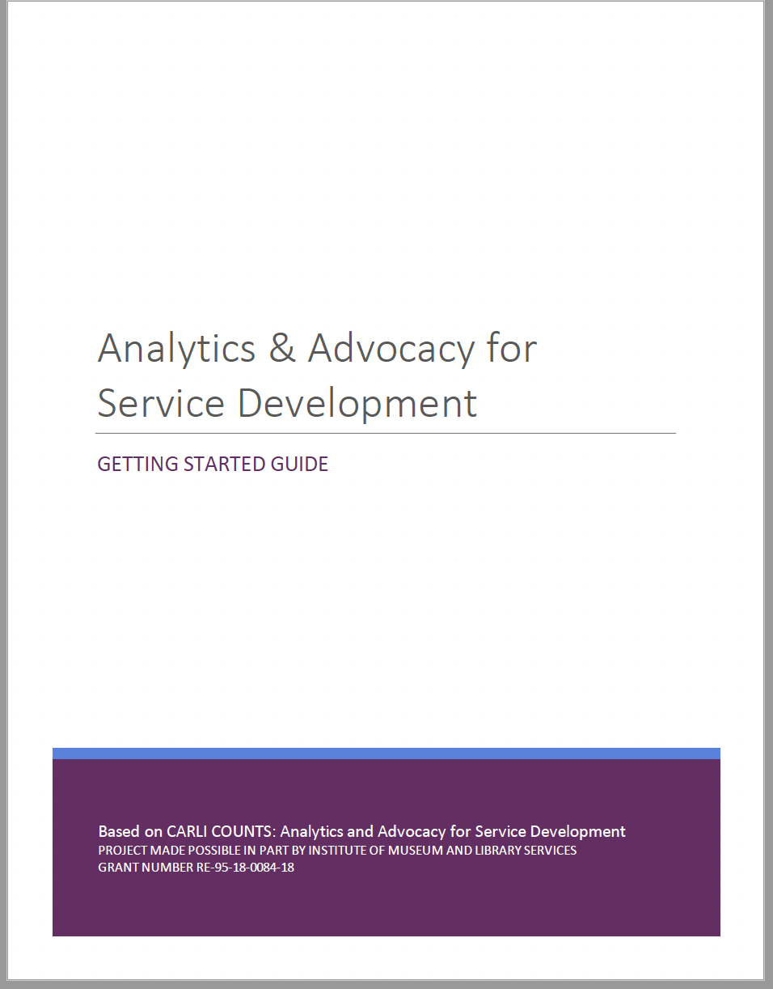
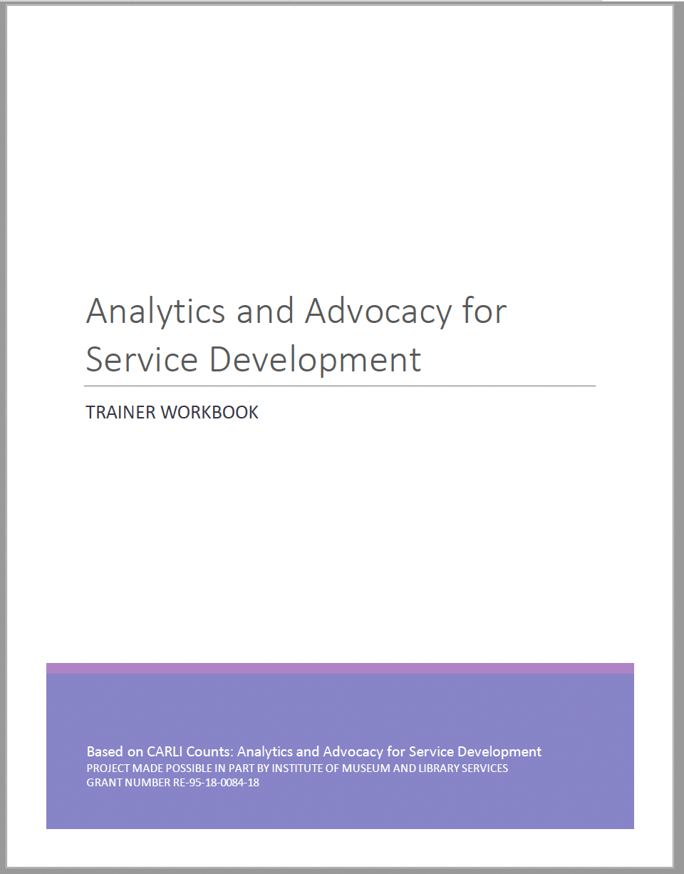
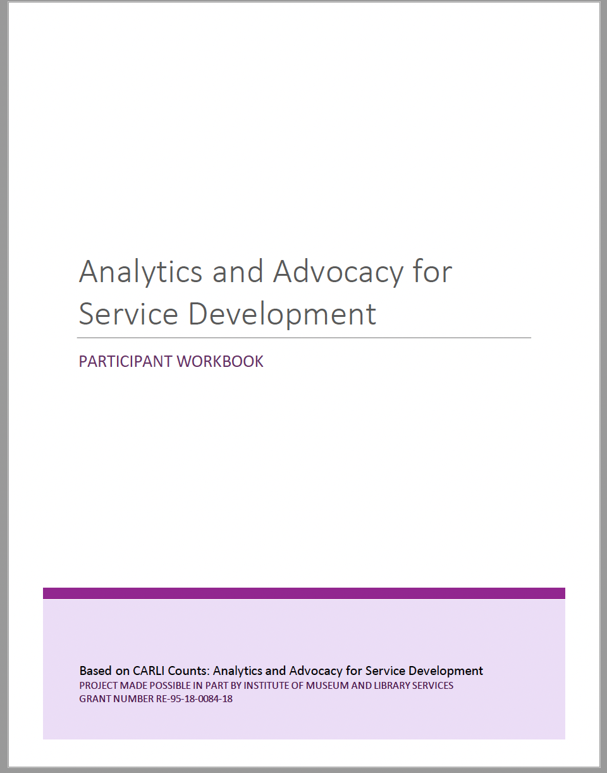
Guide and Workbooks

Slide 30
Presentation Slidedecks
Program Overview
Unpacking Variables & Claims
Research Question Development
The Research Question, Variables, & Methods
Respect for Human Subjects in Advocacy Work
Methods and Participants
Data Analysis and Data Narratives
Community Communication

Slide 31
Poster Template

Slide 32
All resources …
Freely available on the CARLI Counts Website in PDF and PPT formats
Licensed CC BY to facilitate re-use
Provide recommended citation re authorship, etc.

Slide 33
Finding the Files …
https://www.carli.illinois.edu/curriculum-guide

Slide 34
Questions?
Debbie Campbell | Anne Craig | Lisa Janicke Hinchliffe
CARLI Senior Library Services Coordinator | CARLI Senior Director | Professor & Coordinator for Research and Teaching Professional Development, University Library, University of Illinois Urbana-Champaign
dmcmpbll@uillinois.edu | abcraig@uillinois.edu | ljanicke@illinois.edu

Slide 35
CARLI Counts Curriculum Release Party!
Speakers: Debbie Campbell, Program Sustainability for CARLI Counts, Library Services Coordinator, CARLI Anne Craig, Principal Investigator, Senior Director, CARLI Lisa Hinchliffe, Co-Principal Investigator, Professor, University of Illinois at Urbana-Champaign Library
February 23, 2023
This project was made possible in part by the Institute of Museum and Library Services (Grant Number RE-95-18-0084-18)

Slide 36
Abstract
CARLI Counts Curriculum Release Party!
Join us for the virtual CARLI Counts Curriculum Release Party! Learn about these great OERs available from the CARLI Counts project, funded by IMLS. CARLI Counts: Analytics and Advocacy for Service Development • Trainer Workbook • Getting Started Guide • Participant Workbook Project website: https://www.carli.illinois.edu/products-services/prof-devel/carli-counts This project was made possible in part by the Institute of Museum and Library Services, Grant Number RE-95-18-0084-18. Speakers: Debbie Campbell, Program Sustainability for CARLI Counts, Library Services Coordinator, CARLI Anne Craig, Principal Investigator, Senior Director, CARLI Lisa Hinchliffe, Co-Principal Investigator, Professor, University of Illinois at Urbana-Champaign Library

